Slide 1
Hack4Farming - GROUP 7
Zachary Mbaka, Isaiah Muchene, Matt Gathu, Mike Gichia, David Mugume.
Notes:
- disseminating extension information to farmers in real time.

Slide 2
USHAURI
advice
disseminating extension information to farmers

Slide 3
CHALLENGES
Ignorance
Cost
Misinformation
Lack of extension information in very remote areas.
Notes:
challenge to improve farmer’s crop production
Use of inputs remains low
Hence the need to provide information to remedy these
1 Many farmers don’t know if extension advice exists. (Ignorance)
2 Distance to obtain this advice is too long for many farmers or are forced to pay a price. (Cost)
3 Some of the agents are unreliable and may have un-researched information (Misinformation)
4 Many farmers lack access this information. (Resources)

Slide 4
RATIONALE/ASSUMPTIONS
Majority of farmers have feature phones
Organizations have access to smartphones running Android
Notes:
Most farmers (~60%) have feature phones, therefore the most cost effective way to reach them would be through SMS/USSD (shortcodes).
Agricultural field agents employed by government or NGOs have access to smartphones running Android, thus can use ODK to reach farmers at the grassroots.

Slide 5
SOLUTION
Bridge the gap between the farmers and organizations with extension information
Reach the majority farmers using SMS and USSD
Measure impact
Notes:
A platform with USSD & SMS for reaching the farmer & ODK for organizations to collect data

Slide 6
HIGH LEVEL OVERVIEW

Slide 7
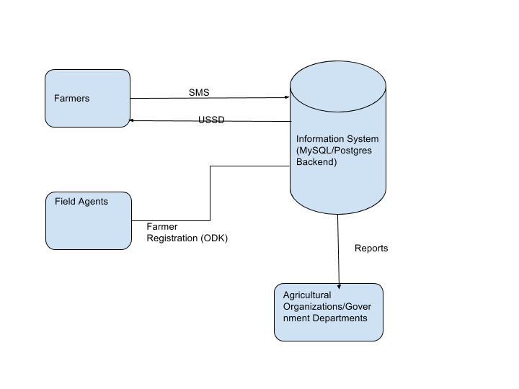

Slide 8
DEMO

Slide 9
ODK

Slide 10
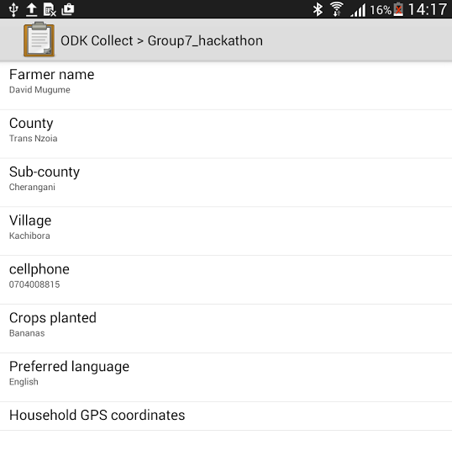

Slide 11
USSD

Slide 12
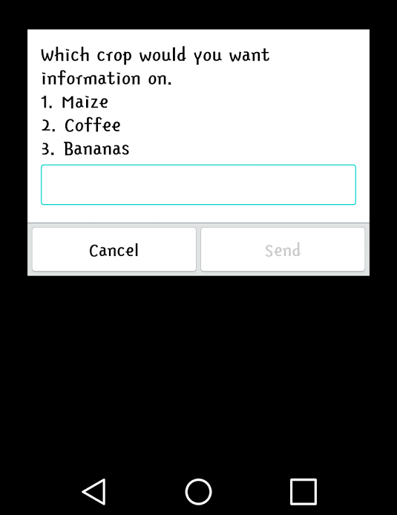

Slide 13
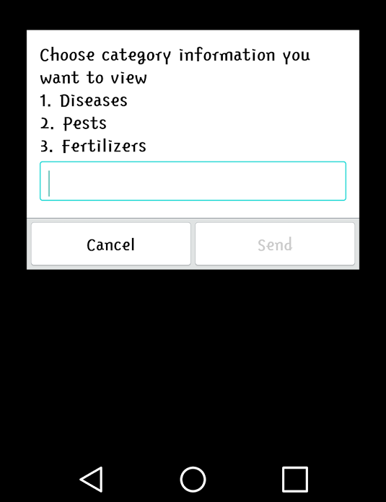

Slide 14
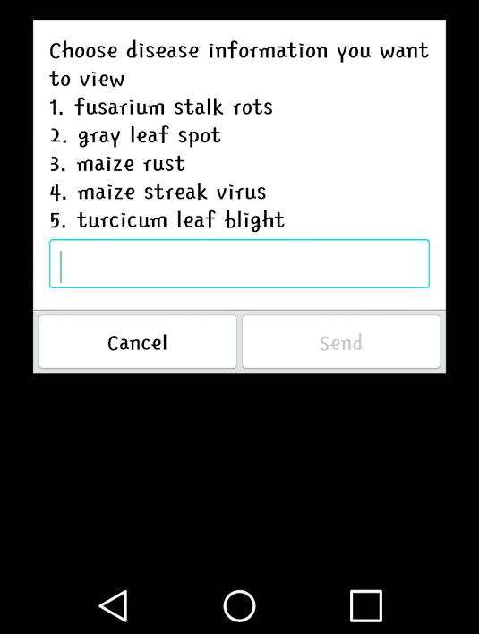

Slide 15
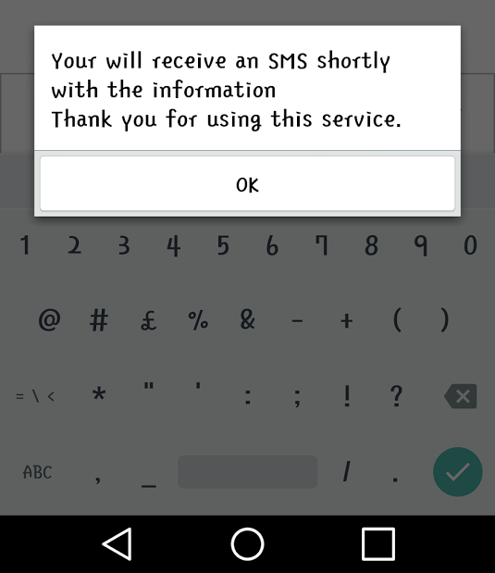

Slide 16
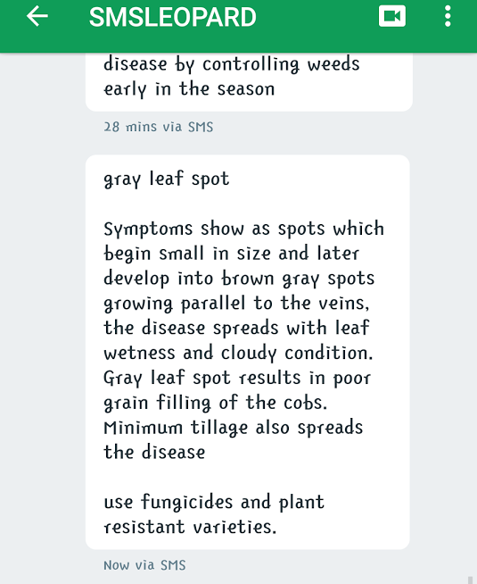

Slide 17
DASHBOARD
http://fierce-bayou-1588.herokuapp.com/
Notes:
For Impact Analysis

Slide 18
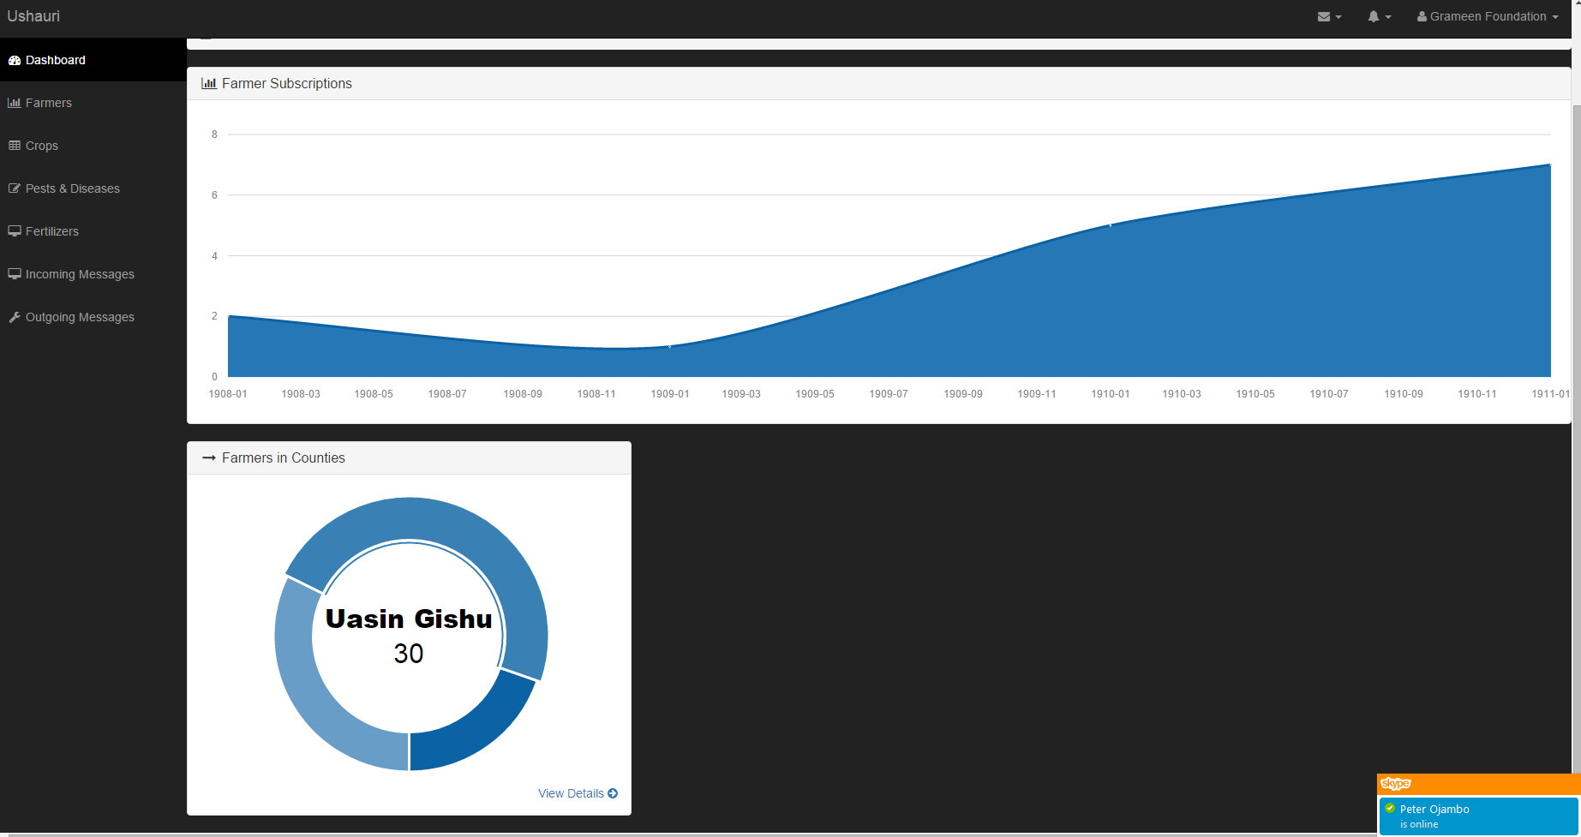

Slide 19
REVENUE MODEL
Provide SMS and USSD applications as a premium service.
customize the platform and deploy it on a customer's infrastructure.
Notes:
SMS and USSD applications as a premium service, charging a reasonable rate e.g. Ksh 2 per SMS or Ksh 3 per USSD request. We’ll be hosting the customer data in this case.
Packaging the entire solution, customize it and deploy it on a customer's infrastructure. The customer hosts the data in this case.
Future Improvements:
Disseminate information on more inputs e.g. improved seeds, farm chemicals.
Data access: allow 3rd parties to access the data - NGOs and government agencies.
Localization: Localize the application to support multiple languages.

Slide 20
INFORMATION SOURCES
Tegemeo Institute Reseach: Information on inputs
Grameen Foudation: Well researched agricultural content
Notes:
Tegemeo Institute Reseach site: http://tegemeo.org/index.php/research/2015-02-17-16-45-32/input-use-agricultural-productivity-commercialization-and-output-markets.html
Grameen Foudation API: http://ckwapps.applab.org/gfsearch/end.php?id=a0r700000068O0CA&menuId=a0Y70000008bdVoE

Slide 21





<tech stack />

